Slide 1

Sales Dashboard Model in Power BI.
Rubén Fernández Martínez
Notes:
https://unsplash.com/photos/PhYq704ffdA

Slide 2


We want be helpful for our customer

Slide 3
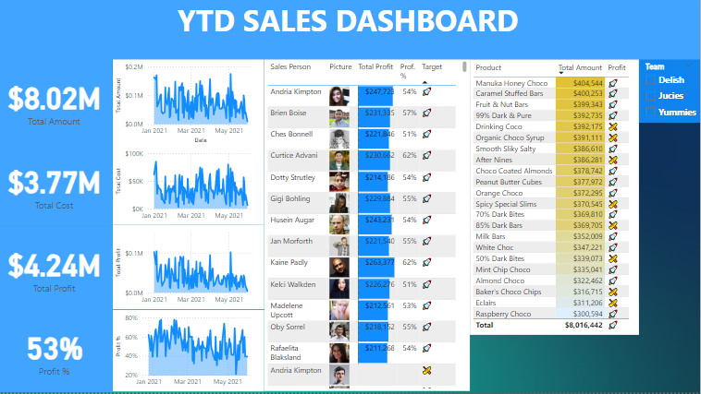
Power BI Sales Dashboard 1/3

Slide 4
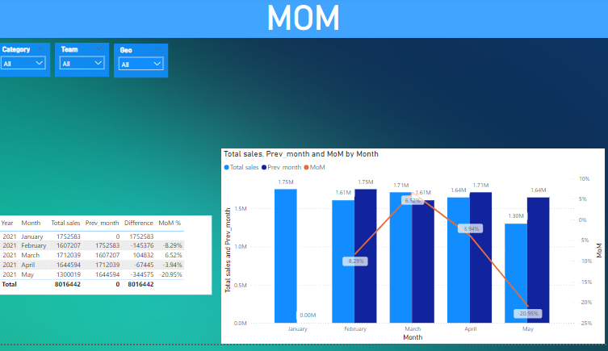
Power BI Sales Dashboard 2/3

Slide 5
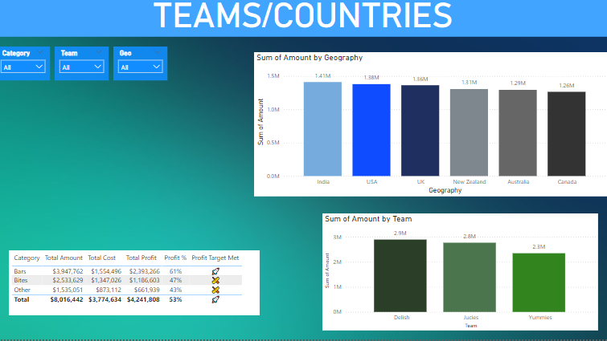
Power BI Sales Dashboard 3/3

Slide 6


We create magic with Data

Slide 7

And detect useful insights for our customers searching for patterns in Data

Slide 8

Thank you.

